Slide 1


More community.
Less busywork.
The operating platform for community clubs.
Memberships, payments, access and staff.
Pre-seed investment opportunity
October 2026
01
Notes:
Clubward connects memberships, payments and daily operations for clubs and communities. Current stage: pre-revenue with active demos. Target pre-seed raise: $100,000–$250,000, confirmed by Katelyn Pauley on October 3, 2026. Brand assets: https://clubward.io/assets/new-home/logo-dark.webp and https://clubward.io/assets/new-home/community.webp. The community visual is illustrative brand artwork, not a customer event.

Slide 2
A community pool’s work spans separate tools
A seasonal community pool prospect uses a binder, spreadsheets and QuickBooks
Household access
Seasonal staffing
Paper records at the gate
Timekeeping and payroll handoff
The pool uses a member-number binder.
Guest visits need tracking against
household pass allowances.
Missed clock-outs create corrections.
The pool reports about 90 minutes
spent on each payroll run.
Clubward connects member and staff workflows
Household records at the gate. Staff time records ready for payroll.
Source: community-pool discovery notes, September 14, 2026. Customer-reported needs.
Prospect example. No measured Clubward savings or customer outcomes.
02
Notes:
Initial-customer evidence: Williamsburg Community Pool discovery meeting, September 14, 2026, from Meeting started 2026_09_14 15_55 CDT - Notes by Gemini (1).pdf, Library libfile_54c1362cfce48191a61682a4710003c6, read October 4, 2026. Pages 2–3 describe QuickBooks/Excel/email/PayPal, household/check-in/guest/staff needs, missed clock-outs and about 90 minutes per payroll run. Page 5 describes a member-number binder and guest-pass tracking; pages 4–5 describe demonstrated scheduling, waiver and check-in workflows. This is an anonymized prospective customer, not a paid customer or measured Clubward improvement. 90 minutes is a customer-reported estimate transcribed in meeting notes, not an independently timed metric. September 22 board proposal, Library libfile_5c5630446c7481918b756a4c0d955d8e version 5, corroborates the operational scope. Direct payroll processing is not promised: current Clubward feature page https://clubward.io/features/ says Payroll Processing is coming soon. The offer here is staff time records and an accounting/payroll handoff with integration scope confirmed during setup. Clubward rebranded the same platform previously discussed as PoolPulse.

Slide 3
First market: US community clubs
Household memberships.
Daily venue operations.
Expansion markets
Gyms and fitness studios
Ski and recreation clubs
Sports and social clubs
HOAs and community centers
Membership nonprofits
Initial focus: swim, tennis and sports clubs
Profile: one venue, household dues and a staffed front desk.
Buyer: manager; spending approved by owner or board.
Purchase window: renewals, opening day or a system change.
Initial sales focus. Adjacent markets expand from the same core as customer fit is validated.
03
Notes:
Proposed initial customer profile: community swim, tennis and sports clubs that run a physical venue, household memberships, recurring dues and a staffed front desk. This profile is a go-to-market hypothesis based on the existing swim-club pipeline and product workflows, not a validated firmographic threshold. Target the operational manager while confirming the person or board with authority to approve spending. Renewal and season-opening timing are practical purchase triggers supported by https://clubward.io/onboarding/ and https://clubward.io/switching/ (accessed October 3, 2026). Larger property, gym, ski, social and nonprofit opportunities remain relevant expansion segments and can also be served opportunistically when the shared modules fit.
US community-club focus sharpens the go-to-market hypothesis. Williamsburg’s general manager and board proposal support a manager-led evaluation with board spending approval. Owner/board is a proposed buyer pattern, not a claim about every club. No verified total of qualifying reachable clubs is available. Build a named target list, deduplicate facilities/organizations, confirm household-dues and staffed-entry fit, and validate purchase timing before estimating a serviceable software market.

Slide 4
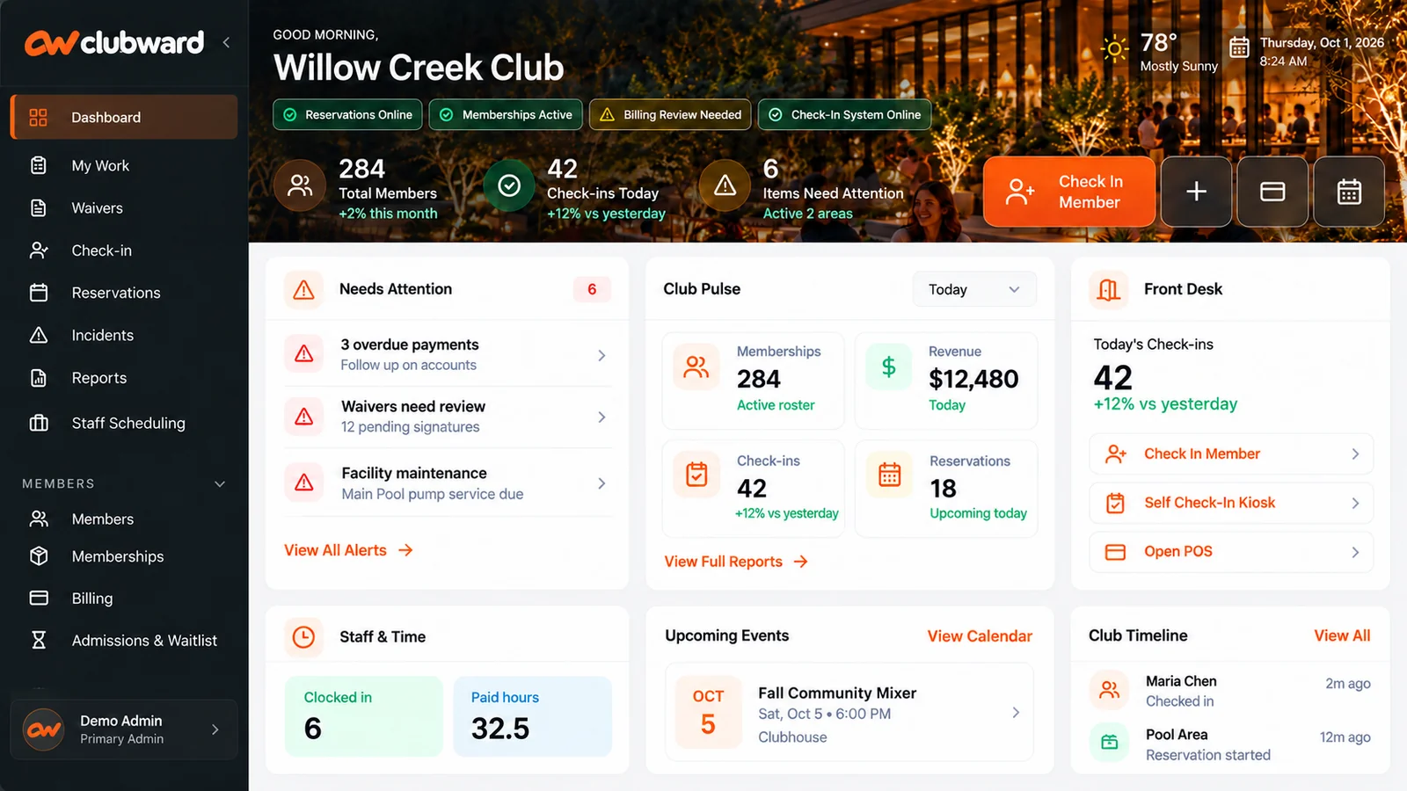
One platform for the community club’s workday
Memberships and payments
Front desk and access
Reservations and programs
Staff operations
Shared records connect member
service with staff operations.
Illustrative product view with demo data
04
Notes:
Capabilities from user-provided Clubward product context and https://clubward.io/. The visual is existing marketing product artwork with fictional demo records, not evidence of actual customer usage or Clubward revenue. Image: https://clubward.io/assets/new-home/overview.webp.
Product scope supported by https://clubward.io/features/ and https://clubward.io/onboarding/, accessed October 4, 2026. Existing product artwork is an illustrative view with demo data, not an authenticated screenshot or proof that every depicted workflow is production-ready. Feature availability and setup are confirmed in a product walkthrough. Payroll Processing is coming soon and is not represented as an available direct-payroll product.

Slide 5
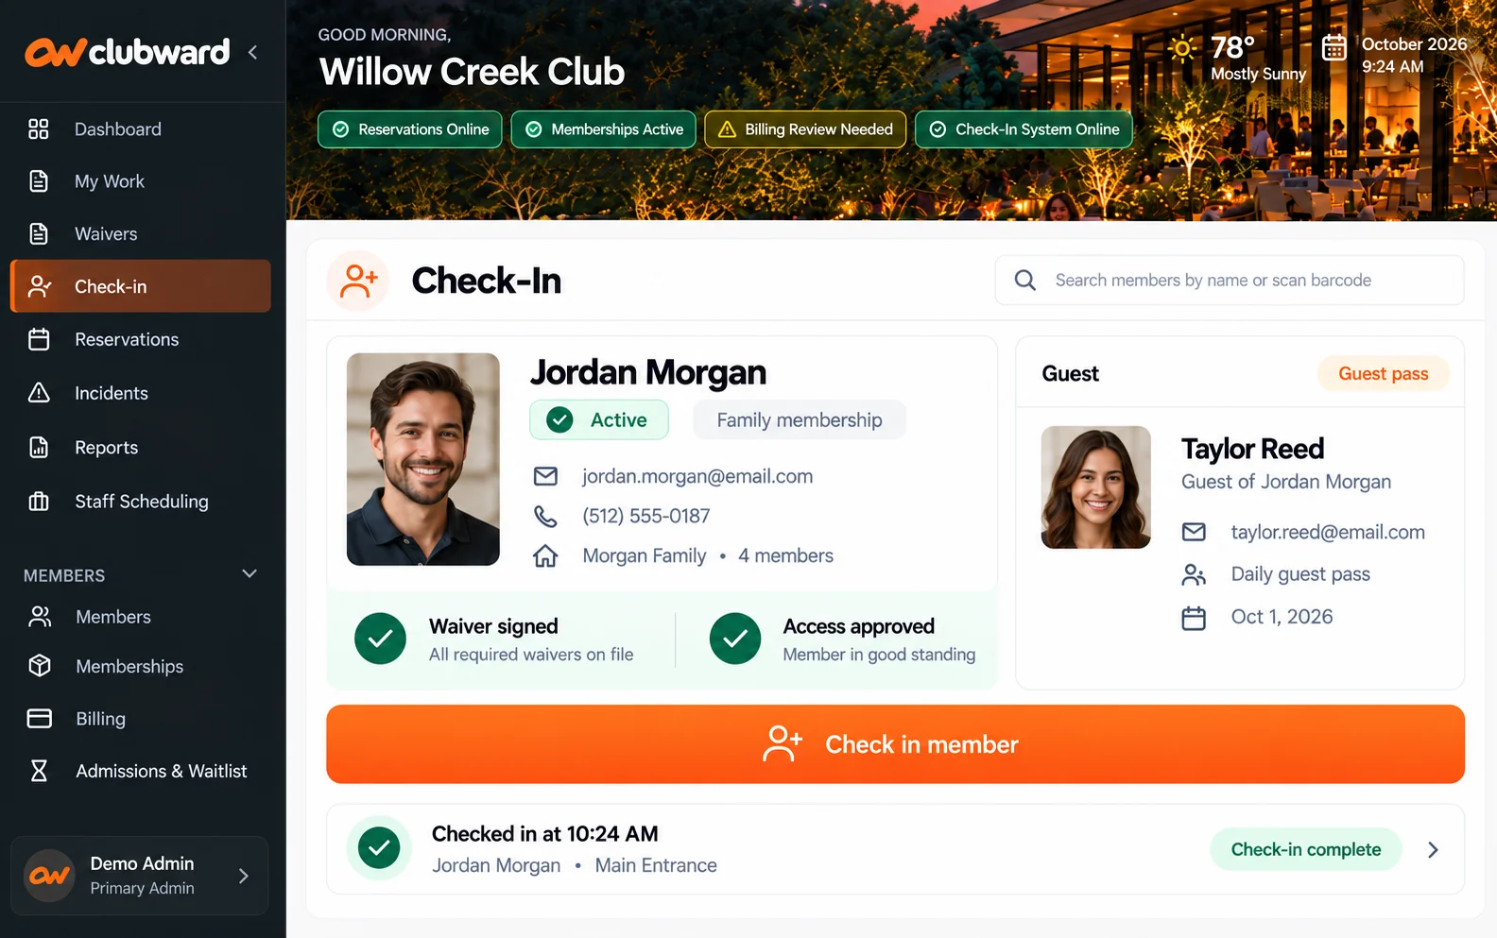
The household record guides guest check-in
A member arrives
with a guest
Find the household.
Review eligibility and waivers.
Record the guest visit.
Guest usage stays with the
household record.
Illustrative view of the discussed guest check-in workflow
05
Notes:
Workflow illustration based on Clubward front-desk capabilities, not a measured performance claim. Image: https://clubward.io/assets/new-home/checkin.webp. Fictional demo member data. See https://clubward.io/ for the product workflow framing.
Concrete workflow discussed in Williamsburg discovery, September 14, 2026, meeting-notes pages 5–7: staff locate a household, see membership and waiver information, and record guest use against membership allowances. Current primary product sources https://clubward.io/features/ and https://clubward.io/onboarding/, accessed October 4, 2026, describe guest passes, member eligibility, waivers and household imports. This slide illustrates the connected-record workflow and does not claim a measured faster check-in time, guaranteed automated admission decision, or a verified live screen.

Slide 6
A club opportunity, with adjacent-market interest
Opportunity | Recorded stage | Next commercial proof
Community pool | Proposal sent | Complete tailored review; agree scope, price and launch date.
Adjacent: youth program | Proposal sent | Validate prepaid accounts and POS fit; agree subscription terms.
Adjacent: residential association | Negotiating | Validate guest access and waivers; agree implementation scope.
Pre-revenue. The next milestone is signed subscriptions and successful launches.
CRM reviewed October 4, 2026. Recorded stages; signed revenue and close dates unconfirmed.
06
Notes:
PowerPulse live CRM reviewed October 3, 2026. Williamsburg Community Pool is proposal_sent, with a custom Clubward demo workspace ready October 1. Element Student Ministry is proposal_sent; a structured deal records a proposal and a September 11 completed-demo note, plus a request for a custom environment. Fantasy World Time Share is negotiating and has documented subscription, pricing and implementation discussions. QA Clubward Shared Lifecycle and TEST records were excluded. No duplicate counting of Element’s account and linked deal. The source tools expose one formal opportunity plus additional advanced lead stages, so this slide describes prospects rather than three normalized deal objects. Recorded deal estimates have unconfirmed billing periods and therefore are excluded from ARR and pipeline value. CRM stages do not establish signed contracts, current buyer engagement, confirmed close dates or revenue. The next commercial steps are proposed actions, not promises from customers.
PowerPulse lead list and Williamsburg account refreshed October 4, 2026. Three relevant recorded advanced stages remain proposal_sent for Williamsburg/Element and negotiating for Fantasy World. QA/test entries excluded. Community pool is the initial-segment opportunity; the other two are adjacent-market demand signals, not validation that each segment has repeatable product-market fit. The custom Clubward demo workspace was provisioned with sample data October 1. Current CRM descriptions do not confirm completed paid launches. No personal contact information or private demo credentials are published in this deck.

Slide 7
Competition and Clubward’s focused offer
Alternative | Published product scope
WildApricot | Memberships, dues, events, communications and websites
Join It | Membership database, recurring billing, cards and member check-in
Club Automation | Fitness and racquet operations, scheduling, billing, POS and staff
Clubward’s focus: community clubs with staffed venues
Household guest access, shift coordination and member payments
in one configured platform, with guided migration.
Purchase-fit thesis; competitive wins still to be validated. Sources: official product pages.
07
Notes:
Primary sources: WildApricot membership-management feature page https://www.wildapricot.com/features/membership-management-software and online-payment/event feature pages, retrieved through web search October 3, 2026. Join It https://joinit.com/features, explicitly describes billing, digital cards, check-in, member database, integrations and branding. Club Automation https://www.clubautomation.com/faq describes single/multi-location fitness, wellness, racquet and multipurpose facilities with membership/staff management, scheduling, billing and POS. This table lists documented scope and deliberately does not infer missing features, poor reliability, legacy architecture or superiority. Clubward’s entry point is a positioning hypothesis from founder-supplied capabilities and current CRM needs: household privileges, daily pass rules, waivers, balances, reservations and staff workflows with guided onboarding. A proprietary or integrated platform alone is not a unique moat. Paid competitive wins and customer reasons for choosing Clubward must validate this positioning.
The focus is a concrete buying bundle for community clubs, not an assertion that competitors lack those capabilities. Published feature scope retained from WildApricot membership features, Join It features and Club Automation FAQ. Clubward sources https://clubward.io/features/ and https://clubward.io/onboarding/ (October 4, 2026) support household access, staffing, payments and guided migration. Validate by recording the customer’s actual alternatives, purchase criteria, reason for selection and delivery effort in the first paid wins. No unsupported feature-absence, pricing, architecture or superiority claim is added.

Slide 8
Sales plan behind the 50-customer target
200 qualified demos at 25% conversion = 50 new subscriptions
Demo-to-paid assumption | New subscriptions | ARR at $500/month
15% | 30 | $180,000
25% target case | 50 | $300,000
35% | 70 | $420,000
About 17 qualified demos per month across 12 months
Qualified means club fit, an engaged decision-maker and an identified purchase window.
Planning assumptions. Launch delays and churn reduce active customers and realized ARR.
08
Notes:
Illustrative sales model, not measured performance or a verified forecast. Assumes 200 completed qualified demos in 12 months, approximately 16.7 per month. Qualified-demo definition is the proposed club profile plus an engaged decision-maker and identified purchase window. At assumed demo-to-paid conversion of 15%/25%/35%, new subscriptions are 30/50/70. At assumed $500 monthly average subscription revenue, annualized recurring revenue is $180,000/$300,000/$420,000 only if all subscriptions launch, remain active and pay that average price. New subscriptions are gross additions; launch delays and churn reduce active accounts. Acquisition effort is additional to demos. Initial period 40 demos, next quarter 60, final six months 100 totals 200; 25% conversion produces cumulative paid launch targets of 10,25,50 if timing holds and all close. Planning case excludes existing pipeline valuation and processing-fee revenue. Measure actual funnel volume, source, conversion, sales cycle and sales labor, and revise after the first cohort.

Slide 9
Guided migration turns a sale into a working club
01
Scope the move
Agree the records, balances and workflows to migrate.
02
Import and configure
Use included setup support or the guided onboarding wizard.
03
Prepare the team
Walk through front-desk work and permissions with staff.
04
Review and launch
Validate the records together and approve a launch date.
First launches measure time to activation, import corrections and delivery hours.
09
Notes:
Clubward’s published onboarding and switching offer, not measured launch performance: https://clubward.io/onboarding/ and https://clubward.io/switching/ accessed October 3, 2026. The website describes included white-glove setup or a guided wizard, member and household imports, validation of opening balances, configuration, staff preparation, operational readiness review and customer go-ahead. No guarantee of migration duration, zero downtime, complete data compatibility or achieved onboarding savings. First launches will measure time to activation, import corrections, staff training effort and support hours.
Guided migration is part of the product offer and must also become a repeatable delivery process. Scope/import/configure/train/review follows https://clubward.io/onboarding/ accessed October 4, 2026. First-cohort evidence should include accepted import, readiness approval, first operational use, customer-reported friction and delivery labor. No migration-duration or cost guarantee. Delivery-cost sensitivity appears in appendix slide 16.

Slide 10
Subscription revenue with modular expansion
Core subscription with optional modules
Core subscription and included onboarding.
Optional modules and capacity can expand each account.
Organizations | $500 / month scenario | Annual recurring revenue
50 | $25,000 MRR | $300,000 ARR
200 | $100,000 MRR | $1.2M ARR
1,000 | $500,000 MRR | $6.0M ARR
Illustrative $500 monthly average. Pricing and delivery sensitivity are on slide 16.
10
Notes:
Illustrative subscription model only. Assumed average subscription revenue $500 per organization per month, or $6,000 annually. At 50 organizations: $25,000 MRR and $300,000 ARR. At 200: $100,000 MRR and $1.2 million ARR. At 1,000: $500,000 MRR and $6 million ARR. These are scale scenarios, not a measured TAM or a forecast. Qualified organizations multiplied by validated annual subscription revenue is the bottom-up serviceable-market method; no current qualified buyer count has been established. Sector counts on the market slide overlap and must not be summed or treated as qualified accounts. Published website https://clubward.io/pricing/ describes core plans, included onboarding, optional modules/capacity and separate payment processing fees. Current numerical catalog pricing was not retrievable through authorized catalog access in this review, so historical pricing and unnormalized CRM estimates were not substituted. Acquisition cost, hosting cost, onboarding labor, support cost, gross margin and retention require validation. No payment-processing revenue is included.
Pricing sensitivity in appendix slide 16 uses assumed monthly averages $300/$500/$700. Historical Williamsburg discussion was an approximate discounted prospect quote, not a signed subscription or verified portfolio average. Published current numerical catalog values remain unavailable in the text retrieval of https://clubward.io/pricing/, accessed October 4, 2026. No actual margin, retention or processing-fee revenue is asserted.

Slide 11
A standalone, proprietary platform
Platform design | What it enables
Proprietary application | Purpose-built workflows in a standalone platform
Connected organization records | Memberships, balances, access and staff operations
Modular architecture | Configure capabilities and extend the shared core
Configured and branded for different markets
Adapt modules, workflows and branding for each market.
Reuse the shared core as segment-specific editions develop.
11
Notes:
Product architecture and expansion thesis, based on founder-supplied context. Standalone proprietary describes the application, not equity ownership or a claim that the investment recipient owns all underlying IP. The commercial platform-rights arrangement is licensed operation as previously described by the founder. Current definitive agreement scope, continuity rights, assignment rights, Clubward rebranding and market-edition rights require transaction diligence. Editions for gyms, ski clubs, HOAs and nonprofits are an expansion strategy rather than a claim of launched editions or effortless entry into every market. Core reuse can still require engineering, integrations and specialized workflows. External infrastructure and libraries remain normal dependencies. No WordPress comparison or direct IP ownership claim.

Slide 12
Founder-led sales to a defined US club buyer
01
Convert the community-club opportunity
Complete the tailored workflow review; agree scope, price and a supported launch.
02
Build a named US club target list
Qualify household dues, staffed entry and purchase timing; reach manager and approver.
03
Repeat the process after early paid conversion
Use direct outreach, search content and capped ad tests. Measure sales and delivery cost.
Serviceable market = unique qualifying clubs × validated annual subscription revenue.
12
Notes:
Proposed go-to-market plan. Founder-led sales converts the existing advanced prospects, then targets clubs that fit the initial venue/membership profile with direct outreach, renewal/opening-day timing and buyer-intent content. Element’s CRM notes record an inbound search/demo request, an early signal for this channel, not proof of repeatable organic acquisition. References depend on successful launches and customer consent. Paid campaigns start as capped experiments and increase only after measuring qualified demos, paid conversion, acquisition cost, onboarding labor, support cost and retention. The proposed acquisition budget is 15% rather than 50% of the target raise.
Named-account targeting is a proposed acquisition process rather than a claim that a verified target list exists. Identify unique US swim, tennis and sports organizations meeting household-dues, staffed-entry and one-venue profile; reach operational manager plus spending approver. Track qualified target count and validated annual subscription price for a bottom-up serviceable-market estimate. Broad sector totals are not multiplied into software TAM. Current demo and proposal interest supports founder-led selling; channel conversion and customer-acquisition cost are not yet measured.

Slide 13
Engineering and customer support experience
Katelyn Pauley
Founder & engineer
20+ years in IT
10+ years in DevOps and SRE
Support engineering and team leadership at Kinsta.
Technical support experience at InMotion Hosting.
U.S. Marine Corps veteran.
13
Notes:
Founder biography from user-provided context: Katelyn Pauley is a software developer, Clubward product builder, US Marine Corps veteran, with 20+ years IT and approximately 10+ years DevOps/SRE experience. Previous positions include Kinsta Support Engineer and Team Lead and InMotion Hosting Technical Support Specialist. This slide does not claim prior startup exits, fundraising history or club-management employment.

Slide 14
Paid-launch targets and the evidence to collect
01
Months 1–3: first 10 paid launches
40 qualified demos at assumed 25% conversion. Record launch and delivery effort.
02
Months 4–6: 25 cumulative paid launches
60 additional demos. Measure activation, support cost and eligible 90-day retention.
03
Months 7–12: 50 cumulative paid launches
100 additional demos. At 50 active accounts and $500/month: $25k MRR.
Planning case from funding close. Launch timing and churn affect active accounts and revenue.
14
Notes:
Proposed targets rather than forecasts or existing achievements. From funding close: months 1–3 target 10 paying organizations, months 4–6 target 25, months 7–12 target 50. The 50-account revenue scenario assumes $500 monthly average revenue and therefore $25,000 MRR/$300,000 ARR. Actual pricing may differ, especially for limited-scope modules or discounted organizations. The target requires customers beyond the current three advanced prospects. An illustrative acquisition requirement is 200 qualified demos over 12 months at an assumed 25% demo-to-paid close rate, approximately 17 demos per month; this is a planning hypothesis with no measured conversion rate. Seasonality, buying committees, onboarding capacity and retention may change the timing. Track time to first operational workflow, onboarding hours, hosting/support cost and 90-day retention of eligible cohorts.
Cumulative launch targets are planned, not current achievements. 40+60+100=200 qualified demos; at assumed 25% conversion these produce 10+15+25=50 launches if all close and launch in the period. Closing is not identical to launching; implementation and buying-cycle timing must be measured. Cumulative launches are not a claim of 50 retained customers. $25,000 MRR requires 50 active accounts paying assumed $500 monthly average; ARR at that point is $300,000. Measure 90-day retention only for cohorts with sufficient observation time. Retention and onboarding cost determine when to increase acquisition.

Slide 15
Proposed $200k pre-seed target
Fund paid launches and validate
a repeatable community-club business.
Proposed use | Budget / share
Team capacity and founder-led sales | $80,000 / 40%
Customer migration, training and delivery | $40,000 / 20%
Product reliability and infrastructure | $30,000 / 15%
Focused acquisition experiments | $30,000 / 15%
Operating reserve: $20,000 / 10%
12-month plan at $15k/month plus reserve. Delivery and runway assumptions: slides 16–17.
Katelyn Pauley
katelyn@clubward.io
clubward.io
15
Notes:
Proposed working funding plan within the founder’s original $100,000–$250,000 range. Target $200,000. Team/founder capacity and early sales $80,000 (40%), onboarding/migration/training/delivery $40,000 (20%), product reliability/infrastructure $30,000 (15%), acquisition experiments $30,000 (15%), operating reserve $20,000 (10%). Total $200,000 and 100%. These are proposed category budgets, not actual salaries, vendor quotes, approved expenses or historical burn. Team capacity covers core founder/team time; the delivery category covers additional implementation and support capacity, so expenditure allocation must avoid double counting. Planned deployment $180,000 over 12 months averages $15,000 gross operating spend monthly, with $20,000 reserved. Excludes existing cash and revenue. Financing/transaction costs reduce net proceeds unless accommodated within the operating categories. Burn can vary month to month. Minimum $100,000 supports approximately 6 months and upper amount $250,000 approximately 15 months at the same spend assumption and 10% reserve. Final financing vehicle and terms remain subject to definitive agreements.
Ask remains a proposed $200,000 working target. Budget allocation is unchanged: team/sales80k, delivery40k, reliability/infra30k, acquisition30k, reserve20k. Team and delivery allocations must avoid double counting. First paid launches, repeatable sales and observed unit economics are the intended evidence purchased by the round. Appendix slide16 models pricing and average delivery-budget allocation; slide17 models runway.

Slide 16
Appendix: pricing and delivery sensitivity
50 active accounts at different monthly averages
Assumed average / month | MRR | ARR
$300 | $15,000 | $180,000
$500 target case | $25,000 | $300,000
$700 | $35,000 | $420,000
$40k delivery budget ÷ 50 launches = $800 per launch
Budget allocation for migration, training and delivery, not measured cost.
Track delivery labor, recurring support and hosting before scaling acquisition.
16
Notes:
Illustrative pricing sensitivity. At 50 retained active paying accounts: assumed monthly average $300 produces $15,000 MRR/$180,000 ARR; $500 produces $25,000 MRR/$300,000 ARR; $700 produces $35,000 MRR/$420,000 ARR. Figures exclude processing fees, one-time receipts and costs; these are not verified published prices or forecasts. Proposed $40,000 migration/training/delivery allocation divided by planned 50 launches equals $800 average allocation per launch. This does not establish actual onboarding cost, customer-acquisition cost, gross margin or payback. Delivery spend can include ongoing work and must not be double-counted against team capacity. Recurring support/hosting costs must be measured separately from launch labor. Gross-margin assessment requires recognized subscription revenue and the actual cost of serving customers, neither of which is validated by this table.

Slide 17
Appendix: funding and runway assumptions
Raise scenario | Operating budget | Reserve | Runway
Minimum: $100k | $90,000 | $10,000 | 6 months
Target: $200k | $180,000 | $20,000 | 12 months
Upper: $250k | $225,000 | $25,000 | 15 months
Calculation: operating budget ÷ $15,000 monthly spend
Proposed gross-spend plan, before financing costs. Assumes a 10% reserve.
Existing cash and customer revenue are excluded. Actual spending may vary.
17
Notes:
Scenario arithmetic: reserve equals 10% of each raise; operating budget equals 90%. At assumed average monthly gross spending of $15,000, $90,000/15,000=6 months; $180,000/15,000=12 months; $225,000/15,000=15 months. This is conditional scenario runway, not measured current runway or an approved budget. No actual burn, current cash balance, financing fees or future revenue has been verified. Fees reduce deployable proceeds and runway unless covered within this spending plan. Additional customer receipts could extend runway but are intentionally excluded from the calculation. Minimum funding may require sequencing or fewer experiments.

Slide 18
Appendix: broader US expansion markets
5,659
55,294
Traditional private clubs
Health clubs and studios
Golf, country, city/athletic, yacht
and racquet clubs. 2023 data.
US locations, including chains.
HFA report published in 2024.
2,800+
373,000
USA Swimming clubs
Community associations
Competitive clubs only.
Directory accessed October 2026.
HOAs, condominiums and co-ops.
2025 estimate.
Additional segments
Recreational swim, ski, sports and social clubs share relevant operating needs.
Source definitions and years differ. Counts overlap and are not additive or qualified buyer totals.
Sources: CMAA (2023 data), HFA (2024), USA Swimming directory, FCAR (2025).
18
Notes:
US segment context, not a single measured software TAM or a count of qualified customers. 1) CMAA reports approximately 5,659 private clubs based on 2023 data. Its February 2025 Board Brief explicitly lists Golf Clubs, Country Clubs, City/Athletic Clubs (including dining-only clubs), Yacht Clubs and Tennis/Racquet Clubs. These can have swimming or fitness amenities, but this source does not establish coverage of every standalone recreational swim club, ski club or commercial gym. The detailed economic impact analysis focuses on 3,887 identifiable clubs with revenue above $1 million. Source: https://www.cmaa.org/board-brief/board-brief-issues/february-2025/ . 2) HFA published a count of 55,294 health club and studio locations in the United States on May 7, 2024, based on analysis compiled by John Dunham and Associates. This is a location count, including chain locations, rather than unique independent organizations or procurement accounts. Source: https://www.healthandfitness.org/the-u-s-health-and-fitness-industry-is-a-22-4-billion-economic-powerhouse/ . 3) USA Swimming’s Find A Team directory describes 2,800+ USA Swimming clubs. These are clubs on the competitive side of swimming. The number is a partial indicator and excludes many recreational/seasonal membership swim clubs, unaffiliated swim teams and other aquatic organizations. It is not a census of privately owned or member-owned swimming facilities. Source: https://www.usaswimming.org/home/find-a-team?findATeamKey=2162 . 4) The Foundation for Community Association Research estimates 373,000 US community associations in its 2025 Fact Book, including planned communities, condominium communities and housing cooperatives. These are an adjacent residential association segment, and not all have shared amenities or fit Clubward. Source: https://foundation.caionline.org/publications/factbook/statistical-review/ . All sources accessed October 3, 2026. The bottom line identifies relevant additional segments, including recreational swim and ski clubs, without claiming a verified current nationwide count. NSCF has a historical March 25, 2020 release describing 640 affiliated ski clubs, but this is old and partial, so it is not included as a current market figure. Source: https://skifederation.org/national-ski-council-federation-expresses-support-to-ski-industry/ . Categories overlap, differ in source year and count locations or organizations under different definitions. Do not add them into a combined private-club count. Independent buyer counts, software budgets, feature requirements and reachable segment size still need validation.
Bottom-up serviceable-market method: count unique organizations that fit the initial customer profile and can be reached, then multiply by validated annual subscription revenue. No verified qualified buyer count is available, so this deck does not assert a numerical serviceable market or multiply sector totals into software TAM.
Broad market evidence is moved to the appendix to avoid implying that traditional clubs, fitness locations, USA Swimming competitive teams and community associations are the initial serviceable software market. Source definitions and overlap remain unchanged. Core GTM targets community swim, tennis and sports clubs with household memberships and staffed venues; broader editions and adjacent workflows follow commercial evidence.

Slide 19
Appendix: US nonprofit technology survey
2025 survey: 306 nonprofit leaders in the United States
34%
60%
Identify as late adopters
See positive technology change
Describe their organization as
a late adopter of technology.
Agree technology is transforming
their organization for the better.
Clubward connects the workflows organizations run every day
Memberships, payments, bookings and access share one platform.
US nonprofit survey. Adjacent-market evidence based on respondents’ own assessments.
Source: Momentive Software, 2025 Nonprofit Trends Report. Survey conducted by Edge Research.
19
Notes:
US evidence: Momentive Software commissioned Edge Research to survey 306 adults in the United States working at nonprofit organizations at director/manager level or higher, using sector lists. Online fieldwork ran February 25 to March 10, 2025. Methodology is on printed page 4. Printed page 6 states 34% consider themselves technology laggards. The deck describes these respondents as late adopters, consistent with the report's technology adoption discussion. Printed page 16 states that 60% overall agree technology is transforming their organization for the better. These are respondents' assessments, not measured ROI or experimentally established effects. This vendor-commissioned study describes an adjacent nonprofit sector, not a representative sample of US clubs or all organizations. It does not estimate Clubward adoption, customer acquisition, retention, product-market fit or probability of success. Clubward's connected-workflows paragraph describes the platform, rather than a measured finding from the survey. Primary report: https://go.momentivesoftware.com/hubfs/001%20Momentive%20Software/MS-Research%20Study/Whitepaper_NP_Research-Study_MP_2025.pdf . Accessed October 3, 2026. Additional UK/Ireland club research appears in the appendix.

Slide 20
Appendix: UK and Ireland club research
2025 survey: 134 golf club managers in the UK and Ireland
64%
66%
Used multiple software providers
Explored alternative software
Multiple tools make integration
an important buying consideration.
Product fit and innovation create
reasons to reconsider suppliers.
Disconnected records turn routine questions into manual work
Membership status, waivers, access rules and staffing need to line up.
Adjacent-market, vendor-involved research. Multiple providers do not necessarily mean disconnected tools.
Source: 2025 Golf Club Software Technology Report; Golf Genius and GCMA published summaries.
20
Notes:
The 2025 Golf Club Software Technology Report surveyed 134 golf club managers in the UK and Ireland. GCMA describes the research as commissioned in July 2024 by GCMA, The Golf Club Secretary, Scottish Golf Club Managers Association, UK Golf Federation and Club Management Association of Ireland; developed by Players 1st in consultation with Golf Genius. Source: https://gcma.org.uk/news/what-we-learned-from-the-golf-club-software-technology-report/ (March 5, 2025). Golf Genius reports 64.18% using a mix of software providers, rounded to 64% here. Source: https://golfgenius.com/about/international/blog/one-big-system-vs.-pick-and-mix-what-works-better (July 25, 2025). Golf Genius reports two-thirds actively exploring alternatives, summarized as 66%. It also describes product fit and innovation as reasons for considering a switch. Source: https://golfgenius.com/about/international/blog/best-in-breed-1?hs_amp=true (June 18, 2025). Accessed October 3, 2026. The research covers an adjacent golf-club segment and includes vendor involvement; it is not a representative study of all US community clubs or all organizations. Using multiple providers does not establish that those tools are disconnected or outdated. The lower portion frames Clubward’s qualitative operating-problem thesis, without claiming measured administrative savings.

Slide 21
Appendix: investment and commercial structure
Domentra Holdings LLC
Proposed investment recipient and commercial operator
Clubward
Customer-facing platform brand with a shared proprietary application
Licensed commercial operation
Investment terms, license coverage and continuity rights
remain subject to definitive agreements and diligence.
21
Notes:
Proposed structure for discussion, not a representation that investment terms or the recipient have been finalized. Prior founder discussions identify Domentra Holdings LLC as the commercial operating entity with licensed rights for the platform previously branded PoolPulse. The current Clubward investment recipient was not conclusively established in available records, so Domentra is explicitly proposed. No claim that Domentra owns all underlying source-code IP. Prior license context contains differing descriptions of brand-specific versus broader exclusivity, so this slide does not represent confirmed exclusive rights across every brand or market. Definitive transaction diligence should establish the Clubward brand, current license scope, rebranding and derivative rights, duration/termination, assignment, service continuity, and any ability of other parties to commercialize the shared core. No SAFE, valuation cap, discount, security or cap table terms are invented.
No definitive recipient, security terms, royalty economics or license execution is inferred. The current proposed commercial structure is preserved pending finalized transaction documents. No assertion about who owns or does not own source-code IP is introduced.

